Slide 1

CSE (H) with specialization in Machine Learning and Artificial Intelligence
Soft Computing (CSF – 332)
Chapter -2.1
Introduction to Neural Network Models
By: Dr. Monika Singh E11032
DISCOVER . LEARN . EMPOWER

Slide 2
Course Objectives
To introduce soft computing concepts and techniques of artificial neural networks, fuzzy sets, fuzzy logic and genetic algorithms
To understand the various techniques from the application point of view.
To analyze various soft computing techniques and decide the technique to be used in a particular problem situation.
To implement soft computing based solutions for real-world problems

Slide 3
Course Outcomes
CO1 | Identify and describe soft computing techniques and their roles in building intelligent. Machines | 1
CO2 | Recognize the feasibility of applying a soft computing methodology for a particular problem. | 2,4
CO3 | Apply fuzzy logic and reasoning to handle uncertainty and solve engineering problems, genetic algorithms to combinatorial optimization problems and neural networks to pattern classification and regression problems. | 3
CO4 | Effectively use modern software tools to solve real problems using a soft computing approach. | 3
CO5 | Evaluate various soft computing approaches for a given problem. | 4

Slide 4
Table of Contents
Associative Memory Networks
Bidirectional Associative Memory (BAM)
Hopfield Networks
Self-Organizing Feature Maps: Kohonen Self-Organizing Feature Maps.

Slide 5
Introduction to Neural Network Models

Slide 6




ACTIVATION FUNCTIONS IN BAM
The activation function is based on whether the input target vector pairs used are binary or bipolar.
Activation function for the Y-layer | Activation function for the X-layer
With binary input vectors | With binary input vectors
With bipolar input vectors | With bipolar input vectors

Slide 7
DISCRETE HOPFIELD NETWORK (DHN)
A single-layer network
each node as both input and output units.
More than an Associative Memory, Discrete Hopfield Network can be used in several applications.
Other applications such as combinatorial optimization.
Different forms: discrete & continuous.
Major contribution of John Hopfield to NN:
Treating a network as a dynamic system.
Introduction of energy function into Neural Network Research.

Slide 8
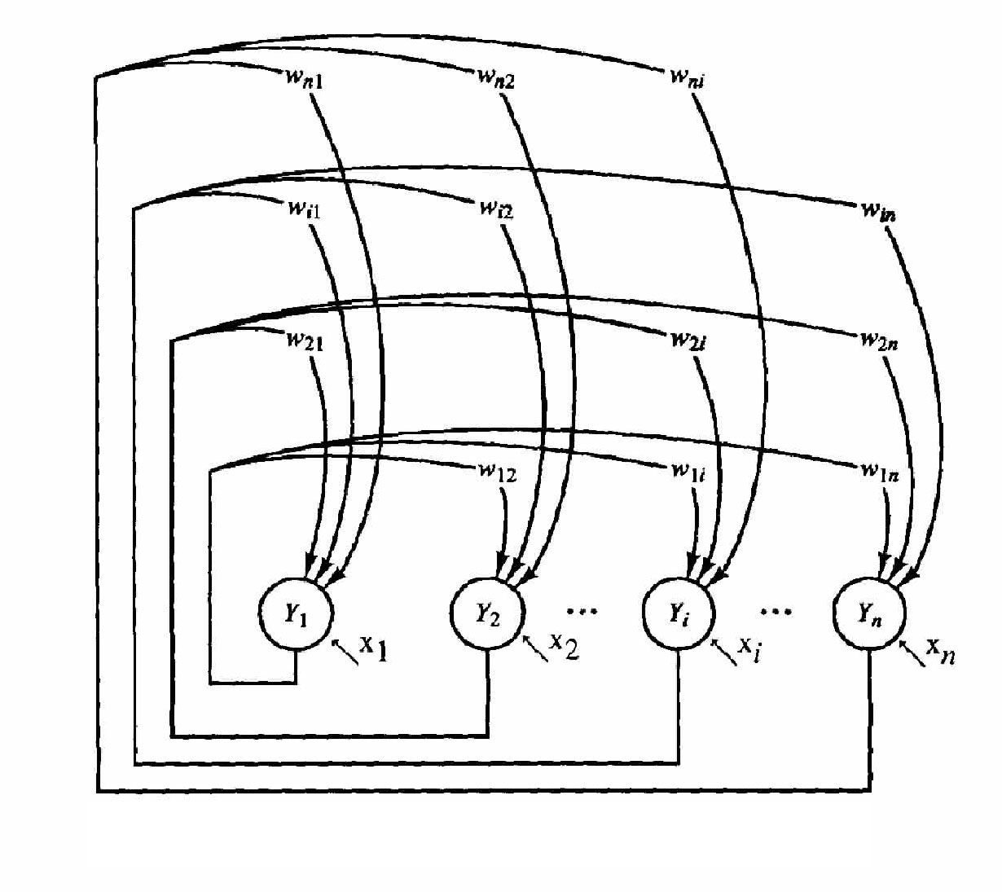
ARCHITECTURE OF DHN
Architecture
Single-layer (units serve as both input and output):
nodes are threshold units (binary or bipolar).
weights: fully connected, symmetric, and zero diagonal.
x_{i} are external inputs, which may be transient or permanent.

Slide 9
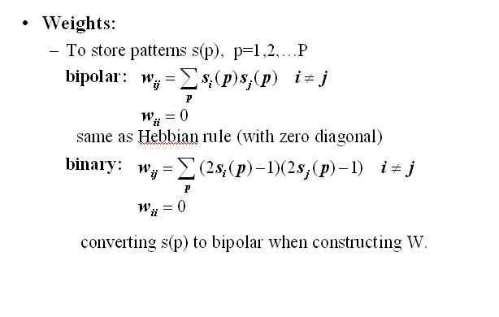

Slide 10
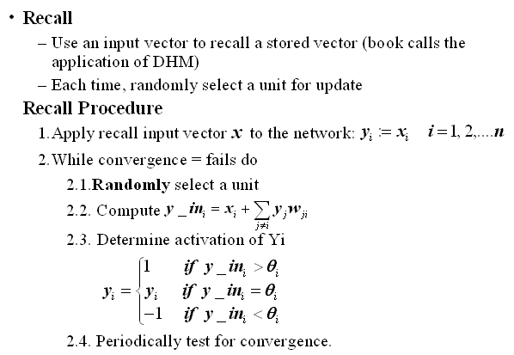

Slide 11
References
“Principles of Soft Computing, 2nd Edition” by S.N. Sivanandam & SN Deepa, Wiley India Pvt. Ltd.
Link :
https://analyticsindiamag.com/6-types-of-artificial-neural-networks-currently-being-used-in-todays-technology/

Slide 12
THANK YOU
For queries
Email: monika.e11032@cumail.in

